Slide 1
URGI platform
PEPI IBIS
June 7th, 2019
joelle.amselem@inra.fr

Slide 2
Context and objectives

Slide 3
URGI platform hosted by URGI research unit
the platform activity is closely related to URGI research activity
Platform
System and database administration
URGI-Blast
Tools distribution
Repeat Annotation
Data integration
User support
Relationships between
platform and research
Research
Tools, pipelines and IS development
VRE development
Expertise for user support, Training

Slide 4
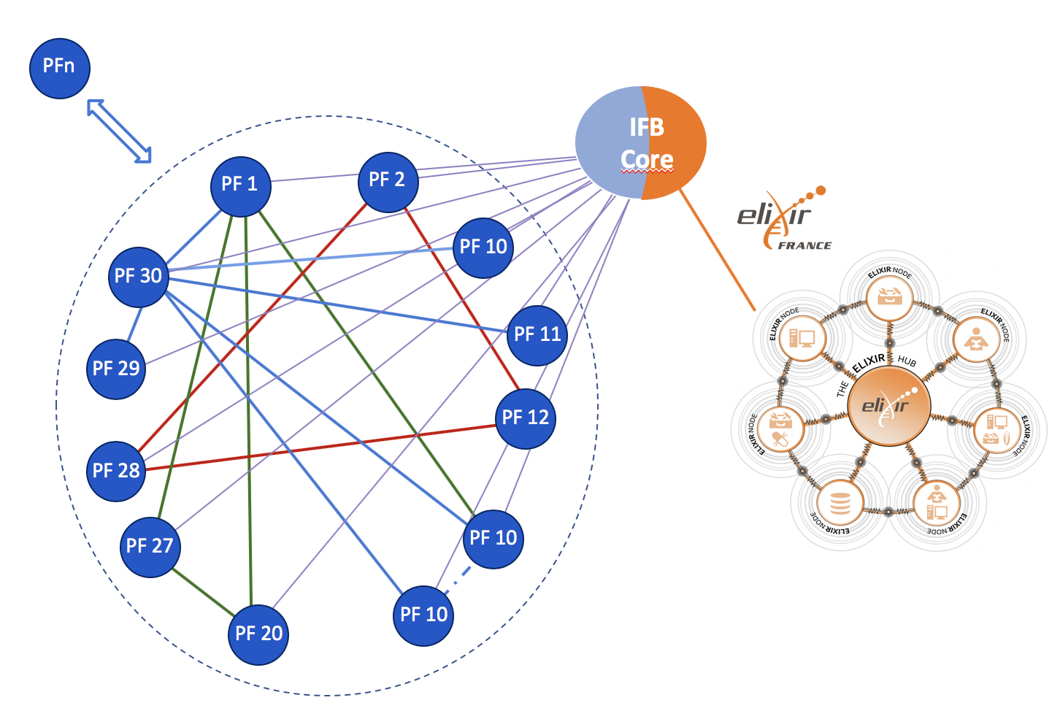
URGI PF → IFB node → Elixir node
IFB structure
A network of 31 PFs
A national Hub: IFB-core
Elixir French Node
Main roles
Provide support for life science research programs
Provide an infrastructure devoted to management and analysis of biological data
EU e-infrastructure
for life science

Slide 5
Platform objectives
Plant and fungi data integration in GnpIS
Give access to computing resources and analysis tools, analysis support
Users training
Valorization / communication
Management of the platform (Human and financial resources, quality process ..)

Slide 6
Platform resources

Slide 7
Skills and expertise of platform members
Informatics
Interface development (Java J2EE)
Development of analysis pipelines (Python)
ETL (Talend, Perl, python, shell)
Databases (PostgreSQL, MySQL, NoSQL technologies (ElasticSearch, Solr))
System administration: HPC, storage, virtualization (Proxmox…), cloud (OpenStack)…
Bioinformatics
Data integration and management of genomic and genetic data (genome annotation, RNA-Seq, polymorphism, Genome wide association studies, phenotype, genetic resources)
Data modelling
Data curation, data annotation (semantics, ontologies, cross-reference, …)
Genome analysis (structure and dynamics)
Repeat annotation (specifically TE)
Gene Annotation (structural and functional)
RNA-seq in the context of TEs

Slide 8
Equipment
Compute and storage
Storage capacity: 358 Tbytes
Computational capacity of Cluster + Cloud: 1206 CPU
Computational capacity of 50 VM servers (ProxMox): 120 CPU
Software/tools available for users: 157
Hosted at INRA IDF datacenter (Bruyère-Le-Chatel)

Slide 9
Services and interactions with platform users

Slide 10
Resources for high-throughput sequence analyses
A service offering aiming at supporting teams from the BAP, SPE and EFPA INRA divisions
Access to URGI computing and associated storage resources
6 month, 1 Tbyte max, (renewable one time): free of charge
More resources/duration : 1 year, 5Tbyte min: 1500 €
Applications
Evaluated once a month
2014-2018 : 38 applications / renewals + 4 contracts
2018: CPU 72805 days
Support

Slide 11
Data insertion and integration in GnpIS
Service offering (free of charge)
Data integration for BAP and EFPA patrimonial data
Genetic resources, network of experiments in crops and forest trees, …
Managed with direct interactions
Data insertion and integration in GnpIS for BAP, EFPA, SPE
Genomic, genetic resources, genetic map, QTL, polymorphism, phenotyping, GWAS …
Applications
If < 3 months of work
5 applications + INRA projects (INRA division support: Siregal, GnpSNP, Forest trees …)
Data integration for project consortia (ANR PIA, EU projects, international projects)
URGI Platform is funded as partner of the project.
Wheat Initiative and IWGSC data are integrated free of charge.

Slide 12
Training
Focus 2017
3 GnpIS webinars
Standardizing phenotyping experimental data
Synteny data visualization into GnpIS
GnpIS for BreedWheat data
1 TE annotation @URGI
Annotation of transposable elements
2 TE annotation @Elixir-nodes (Slovenia + Portugal)
In the frame Genome assembly and annotation course

Slide 13
✳️
Management staff
Unit Director: Hadi Quesneville
« Information System and Data Integration » Team
« Genome Analysis » Team
Administrative staff
Leader: Anne-Françoise Adam-Blondon ✳️
Deputy leaders: Michaël Alaux ✳️, Cyril Pommier ✳️
Leader: Hadi Quesneville ✳️
Deputy leaders: Joëlle Amselem ✳️, Florian Maumus
Claire Guerche
Raphaël Flores ✳️
Erik Kimmel ✳️
Thomas Letellier ✳️
Célia Michotey ✳️
Nacer Mohellibi ✳️
Françoise Alfama ✳️
Nathalie Choisne ✳️
Johann Confais ✳️
Véronique Jamilloux ✳️
Hervé-Antoine Kerjean ✳️
CSDs
Mélanie Buy
Jérémy Destin
Bilal El Houdaigui
PHD student & Post-doc
Vikas Sharma
Private permanent contact
Dorothée Charruaud
CSD
Agnès Baud
Mariène Wan
Platform
✳️
Scientific Manager: Anne Françoise Adam-Blondon Operating Manager: Joëlle Amselem
Notes:
A mettre à jour
Ajouter un icone a coté des PF

